Slide 1
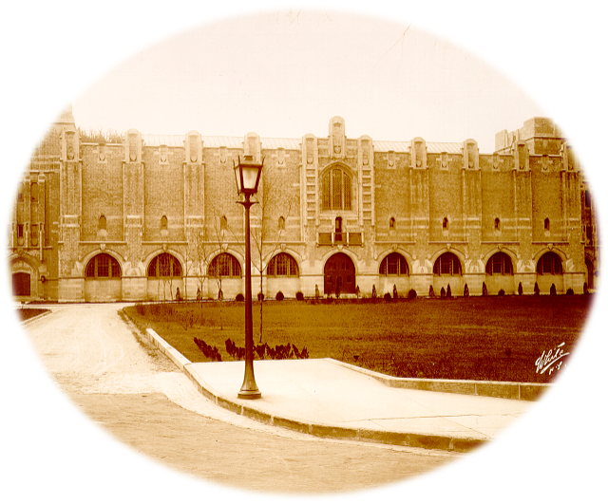

Historical Perspective
Sports Medicine-Physical Therapy Doctoral Program
“Academic, Research, and Clinical Excellence”
LTC J. Parry Gerber PhD, PT, ATC, SCS
U.S. Military- Baylor University
Post-professional Sports Medicine- PT Doctoral Program
West Point, New York

Slide 2
WEST POINT
Notes:
West Point – all about historyContributions to the history by former resident – Randy Green

Slide 3
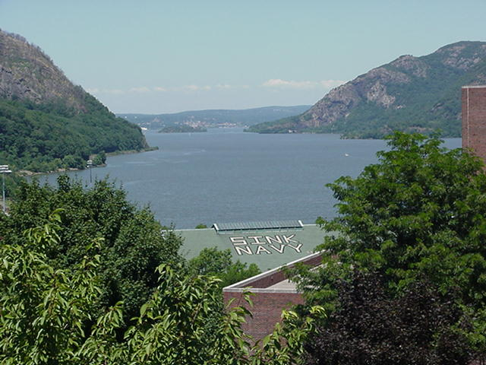
Notes:
Rich in tradition

Slide 4
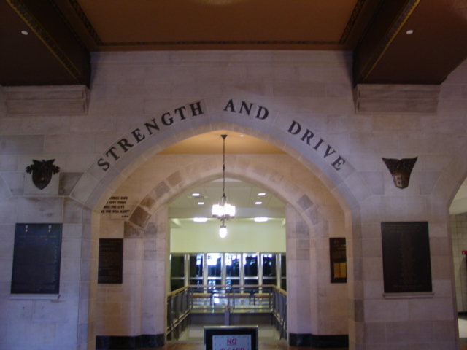
United States Military-Baylor University Post-Professional Sports Medicine-Physical Therapy Doctoral Residency
…Re-invented me as a PT.
Capt Fink
Great experience!…
Crazy not to apply.
Maj Weishaar
Outstanding Opportunity to excel outside of the clinic
Lt Col Green
Lt Col Randy Green
PT, DScPT, OCS, SCS
Notes:
Randy Green – gave this as part of a briefing to the AF
Important to know the history

Slide 5

We were here
Notes:
Prior to 1994ish – PT had a little space in Malogne (Cadet health clinic)

Slide 6
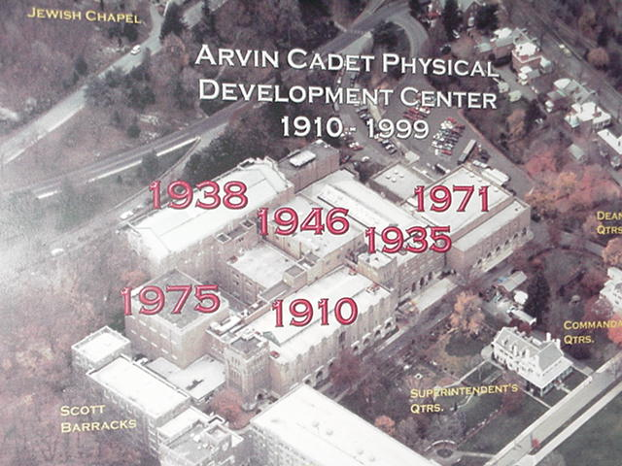
Notes:
Sneaky – get us in the gym, they would have to deal with us for renovation (great move by Chuck Scoville)

Slide 7
2000-2006
Notes:
3 phase renovation project keeping the historical presence –
Use to be a maze to go to rball, gymnastics, stairs warped, small doors, very unique.

Slide 8
2007-2010
Notes:
All buildings torn down – now with our own clinic.

Slide 9
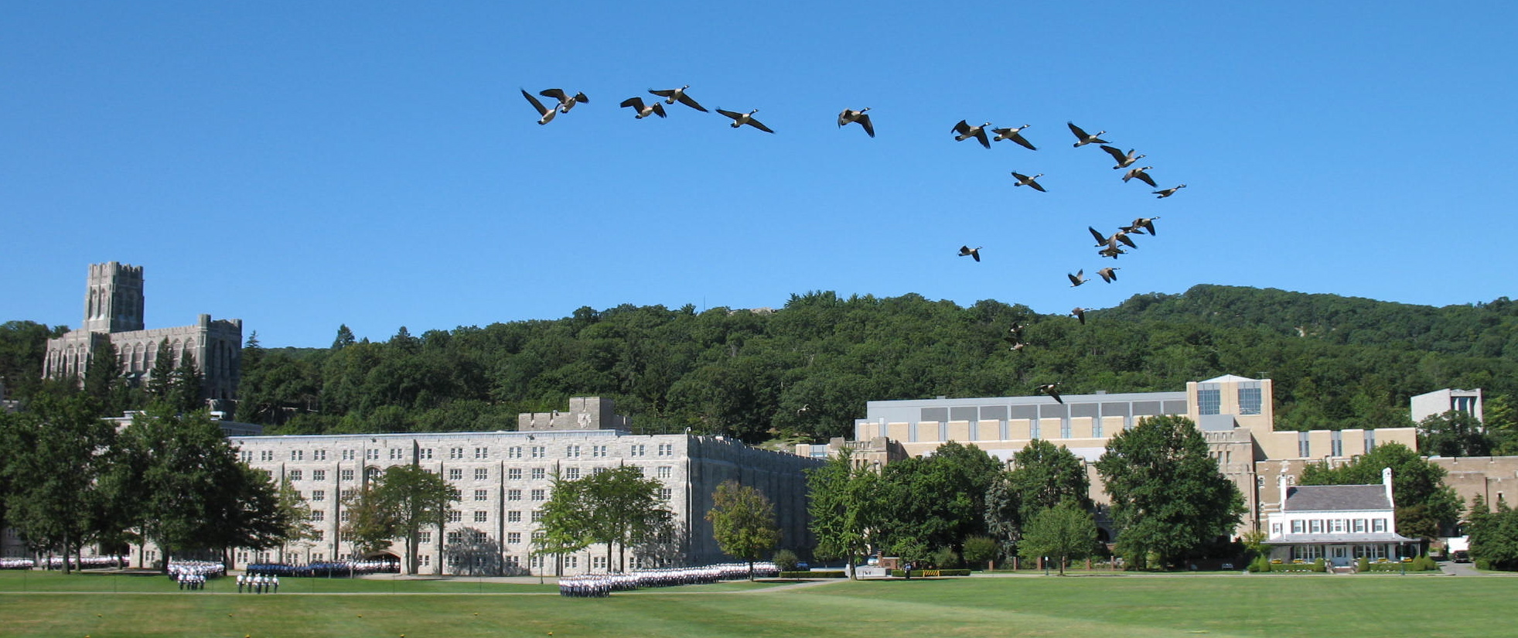
Notes:
Here’s the new building seen over the old one.

Slide 10
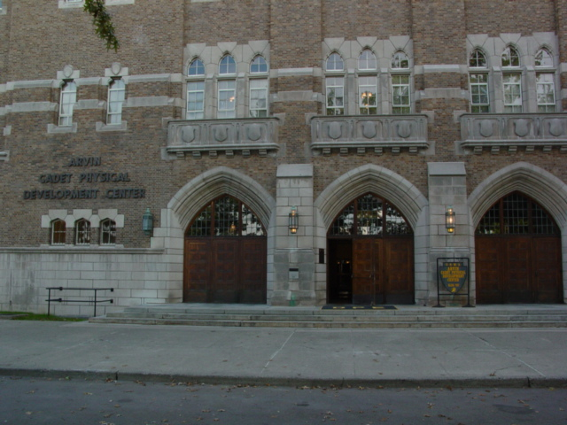
West Point Sports Medicine-Physical Therapy Residency: 1995-1996
  If you build it . . . they will come.
LTC J. Parry Gerber
1996
LTC Chuck Scoville
LTC Steve Bullock
1995
Notes:
Front doors how they used to look.
Sort of a “Field of Dreams” – this started out as an idea from being around the ortho surgeon fellowship.

Slide 11
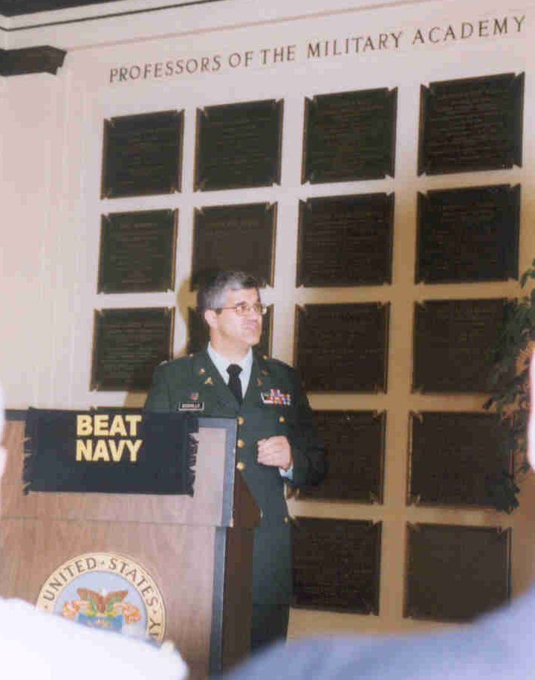
Chuck Scoville

Slide 12
Chuck Scoville
Chief of West Point (1992-1996)
Director of Residency for the 1995 &1996 graduating class
Got it started
If you build it . . . they will staff it, fund it, etc. No set organization to the residency - basically an idea to be developed and refined
Notes:
The idea really came from the ortho surgeon fellowship – the PTs here watched year after year and thought – “We should do the same thing for therapists”

Slide 13
Class of 1995
Director: Chuck Scoville
Resident: Steve Bullock
Curriculum:
  Consisted of a huge stack of articles that the director had accumulated over the years. Sections were basically divided into tendon, shoulder, knee and ankle general areas. One of Steve’s assignments was to “weed out” articles that didn’t have much value for the next year’s resident. Classes (or class fragments) were “fit in” during the day’s slow times. The format was essentially the instructor and resident sharing what they felt were important points in the article.
Athletic Training:
  Used the Arnheim text as curriculum. Mostly self-taught with a syllabus provided by the Department of Physical Education (DPE) head trainer. Covered intramurals with DPE during the fall from Sep-Apr.

Slide 14
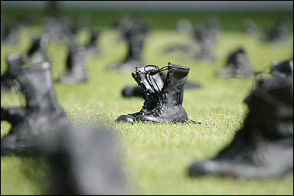
Class of 1995
Director: Chuck Scoville
Resident: Steve Bullock
Time:
  Residents worked normal clinic hours:
  0530-1130, 1300-1600: Summer
  0630-1130, 1300-1430: School year. (1430-1830 athletic training)
  No particular times were set aside for research, study, classes.
  The resident would fit those things in whenever possible during “slow” times. He rotated through the weekend inpatient call and weekend sports coverage.
Notes:
Back when they wore black boots.

Slide 15
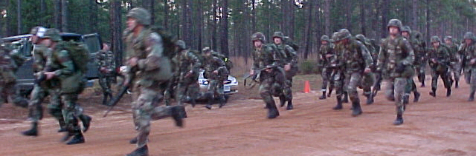
Class of 1996
Director: Chuck Scoville
Resident: Parry Gerber
Curriculum:
  Similar to the previous year - sections were basically divided into tendon, shoulder, knee and ankle general areas plus an enormous modality section was added. Curriculum consisted of the same huge stack of articles. One of Parry’s job was again to “weed out” “insignificant” articles. Classes were again “fit in” where possible with the same format of instruction. After the tendon curriculum, however, very few classes were actually held due to a very busy clinic and an equally very busy chief.
Athletic Training:
  Used the Arnheim text as curriculum. Mostly self-taught with a syllabus provided by the Department of Physical Education (DPE) head trainer. Covered intramurals with DPE during the fall from Sep-Apr. A midterm was given in December, a final exam was given in April.
Time: Similar as the previous year
Notes:
Staff was relatively small – chief had many responsibilities
Felt frantic – like a year long sprint

Slide 16
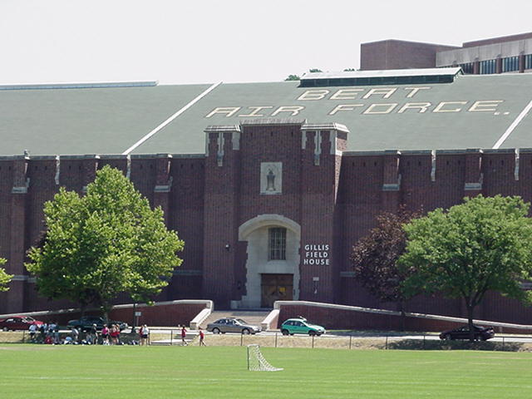
Notes:
West Point – an unique area

Slide 17
West Point Sports Medicine-Physical Therapy Residency: 1995-1999
  The first ever clinic residency (of any kind) recognized
  by the APTA was this residency in 1999.
LTC Allyson Pritchard
1999
Lt Col Steve Steocker
LCDR Rod Clayton
1998
LTC Barb Springer
LTC Greg Weaver
LTC Timothy Gangel
1997
COL Joseph Molloy
LTC J. Parry Gerber
1996
LTC Chuck Scoville
LTC Steve Bullock
1995

Slide 18
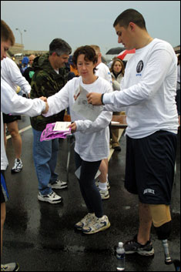
Barb Springer

Slide 19
Barbara Springer
Chief of West Point and Director of the Residency (1996-1999)
  First chief to have a former resident (Parry Gerber) stay as assistant director. Staff therapist Glenn Williams (very research oriented) also remained on staff
If you organize and promote . . . they will recognize it, staff it, fund it, etc.
One of her top priorities was to provide better overall organization and structure to the residency
  The first ever clinic residency recognized by the APTA was this residency in 1999.
Notes:
The biggest complaints of the first 2 residencies:
Too much chaos, lack of organization, Director has too many responsibilities.
So – the big focus was to have some structure.

Slide 20
Class of 1997
Director: Barb Springer
Residents: Joe Molloy & Tim Gangel
Curriculum:
  From the “weeded out” stack of articles, the first written curriculum was created and organized through the combined efforts of Barb Springer, Parry Gerber, and Glenn Williams. Each major section area was subdivided into topics with specific goals attached. Several text book reading assignments were included along with some video tape lectures. Stress fractures and statistics was added to the curriculum. Classes were scheduled from July - Mar and held on a regular basis, usually 2-3 days per week lasting for 1-1½ hours. However, it was not infrequent to have a class start late and run into “free” time (for example lunch). It was also not uncommon to have classes postponed due to unforeseen events (i.e., clinic matters, patient care, other).
Notes:
First year with more than one resident.
Director still dual hatted – Much better division for classes with Barb, Parry, and Glenn

Slide 21
Class of 1997
Director: Barb Springer
Residents: Joe Molloy & Tim Gangel
Athletic Training:
  The DPE trainers were given an outline of topics to cover. Each trainer rotated to teach a 1-2 hour class on a weekly basis. Topics were based out of Arnheim’s text once again. Classes were organized and well done . . . when they were given. There were many conflicts in schedule from the DPE side of things, and many classes were also canceled due to lack of DPE preparation time (2 of the 3 trainers arrived in July for their first year at West Point). A final exam was given in April.
Notes:
First time we had DPE trainers teach
First time we had an exam of any kind
One thing to realize is that things/staff changes frequently – often makes you change quickly as well.

Slide 22
Class of 1997
Director: Barb Springer
Residents: Joe Molloy & Tim Gangel
Time:
  We changed the summer hours to 0630 – 1600 and dropped off Saturday coverage altogether. Residents rotated for Saturday inpatient coverage and morning hospital work every other week for the first half of the year and then both of those rotations were dropped. Every other Friday afternoon was set aside for “Independent Study and Research Time (ISRT)”.

Slide 23
Class of 1998
Director: Barb Springer
Residents: Rod Clayton & Greg Weaver
Curriculum:
  The curriculum followed a similar format from the previous year. To refine the curriculum, residents and faculty would judge the reading assignments as essential or nonessential and revise the curriculum. A section on basic science was added to the curriculum. The modality section was greatly reduced (by about 80%) and included in the basic science curriculum. Class schedule was similar to the previous year. A good improvement was made in starting and ending classes on time. We probably had to postpone class 20% of the time for one reason or another.
Notes:
First Navy participant. This residency was complicated by the advance course that Parry attended for several months.

Slide 24
Class of 1998
Director: Barb Springer
Residents: Rod Clayton & Greg Weaver
Athletic Training:
  DPE – A better commitment from the head trainer to have a more structured curriculum fell through as the head trainer took a job elsewhere. That left a shortage in DPE staff for several months. Classes went about like the year before. A final exam was given in March, before the SCS exam.

Slide 25
Class of 1998
Director: Barb Springer
Residents: Rod Clayton & Greg Weaver
Time:
  The same summer schedule was kept. Residents rotated one afternoon a week at the hospital plus Friday mornings before ortho rounds to have experience with inpatients. Every other Friday afternoon was still set aside for “Independent Study and Research Time (ISRT)”.
Notes:
This residency in my opinion may have had the worst experience overall. The staff to cover 2 clinics was Barb Springer, Parry Gerber, Glenn Williams. Parry and Glenn both missed a few months due to the “Advanced Course” (now called the Captain’s Career Course). Residents worked at the hospital once a week basically to help the staff. The DPE staff had similar difficulties. Couple that with the residents – one wasn’t interested much in the on-field stuff, the other wanted to exclusively be with the trainers. (The Navy didn’t send anyone for a while after this year)

Slide 26

Class of 1999
Director: Barb Springer
Residents: Allyson Pritchard & Steve Stoecker
Curriculum, Athletic Training, Time:
  All similar to the previous year with better overall follow through.
Notes:
First Air Force Resident
Much better all around – more stable staff in both PT clinic and with athletic trainers –
Barb Springer worked incredibly hard to get the APTA credentialing complete.

Slide 27
West Point Sports Medicine-Physical Therapy
APTA Credentialed Residency: 1995-2000
LTC Tim Pendergrass
2000
COL Josef Moore
LTC Allyson Pritchard
1999
Lt Col Steve Steocker
LCDR Rod Clayton
1998
LTC Barb Springer
LTC Greg Weaver
LTC Timothy Gangel
1997
COL Joseph Molloy
LTC J. Parry Gerber
1996
LTC Chuck Scoville
LTC Steve Bullock
1995

Slide 28
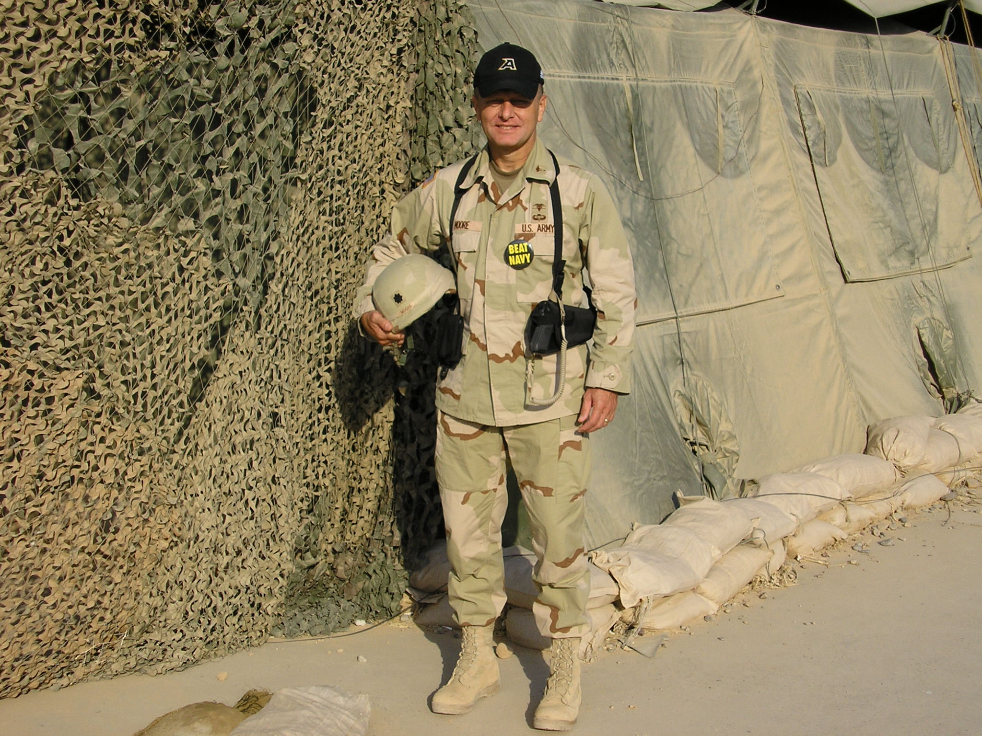
Joe Moore

Slide 29
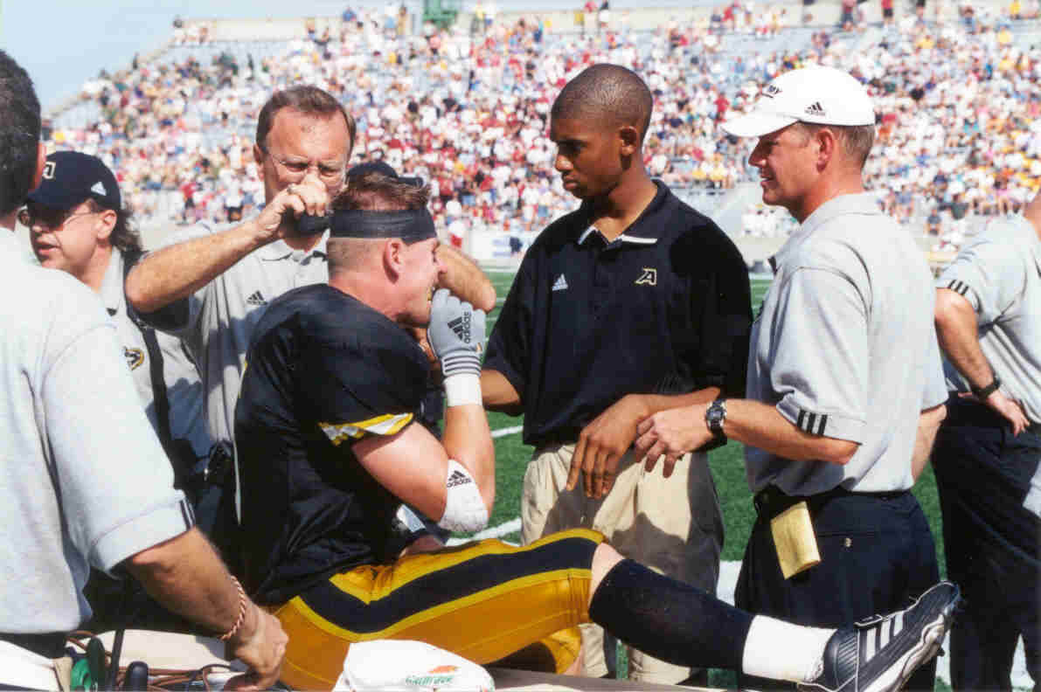
Class of 2000
Director: Joe Moore
Resident: Tim Pendergrass
Curriculum, Athletic Training:
  Similar to the previous year.

Slide 30
Class of 2000
Director: Joe Moore
Resident: Tim Pendergrass
Time:
  This was a transition year with the new director (Joe Moore) coming on staff. Essentially, the same overall schedule and organization continued. Tim Pendergrass was the first resident to go through the residency since it became credentialed by the APTA. It appeared that the curriculum for didactic instruction, athletic training activity, and clinical rotations over the previous years did not always match what was written as a part of the overall curriculum or what was experienced by the residents.
  Secondly, the residency was beginning to be expanded to 18 months, changing to a quad-service program and beginning a revised new academic, clinical, and research curriculum.

Slide 31
Joe Moore
Chief of West Point and Director of the Residency (1999-2002)
  Parry Gerber left in the summer of 2000. Tim Pendergrass (resident 1999-2000) remained on staff as assistant director.
If you push and persist . . . they will grant a degree.
One of his top priorities was to organize the curriculum in a manner consistent with the Baylor model to become a Doctorate of Science degree producing program.
The sports-medicine physical therapy residency extended to an 18 month program and offered the DSc degree in 2001.
Notes:
First director from the school house – saw things from different angles. This is a good example of why it’s good to have new blood circulate through programs. Was developing into quite a good program – but would be better.

Slide 32
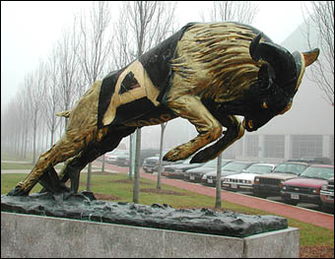

Slide 33
West Point Post-Professional Sports Medicine-Physical Therapy Doctoral Residency: 2001-2011
  APTA credentialed program
  Doctoral program affiliated by Baylor University
*WARNING*: It is required to complete and Submit Individual Research to Peer-reviewed, Indexed Journal
Maj Mark Weishaar
LTC Danny McMillian
2003
LCDR Mike Rosenthal
COL Josef Moore
Lt Col Randy Green
LTC Richard Baxter
2001
LCDR Scott Jonson
Notes:
Now you have 2 distinct programs – at the time, basically with the same requirements. The APTA basically accepted what we did for Baylor as good enough for the residency.

Slide 34
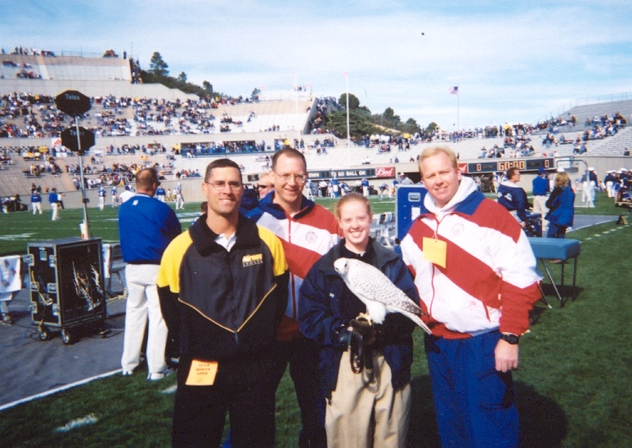
"Upon the fields of friendly strife are sown the seeds that upon other fields;
on other days, will bear the fruits of victory."
MACARTHUR'S OPINION OF ATHLETICS
Note: No one considered posing with the Army mules

Slide 35
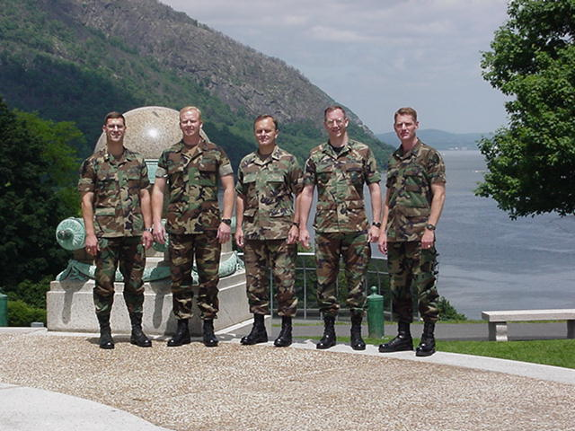
Class of 2001
*PT Pete*
Notes:
First year with 3 residents. One of the most significant changes was the hiring of a civilian (reservist) PT (Pete Battapaglia) to the hospital clinic. This freed up time to do more. These few years enjoyed the best staffing for therapists and techs in the history of the residency. The Director still had multiple responsibilities – therapists usually rotated.

Slide 36
Class of 2001
Director: Joe Moore
Residents: Randy Green, Mike Johnson, Rich Baxter
Curriculum/time:
  Curriculum shortened
  Class times were in the afternoon during the summer, from 1000-1200 during the fall, and formal classes ended in January to allow residents to concentrate on patient care, research, SCS exam, etc.
  Ankle, knee and shoulder with a large emphasis on instability was the focus as instability of the ankle, knee and shoulder are West Point’s legacy.
  The curriculum areas followed the APTA guidelines and was geared toward preparing residents for the SCS exam.
*PT Pete*
Notes:
First year with 3 residents. One of the most significant changes was the hiring of a civilian (reservist) PT (Pete Battapaglia) to the hospital clinic. This freed up time to do more. These few years enjoyed the best staffing for therapists and techs in the history of the residency. The Director still had multiple responsibilities – therapists usually rotated.
First year with 3 residents. This was still a 1 year residency. Biggest changes – research requirement ramped up, much less reading required. More “research reading sharing” -Revised: While it was felt the curriculum had valuable information it was still too long and inefficient. Residents (and instructors) had to read and re-read the same curriculum year after year. As new information surfaced, the curriculum would either continue to expand or parts will be dropped that could contain important information. Less required reading assignments were given with the thought that much time would be required to create power point presentations. Part of the residents’ curriculum was to review “new” literature for that year and make the power point slides for the curriculum for the upcoming residents. The thought was that would help the curriculum grow in a systematic way without loosing “old” important information.

Slide 37
Class of 2001
Director: Joe Moore
Residents:Randy Green, Mike Johnson, Rich Baxter
Athletic Training:
  Essentially the same schedule
  DPE trainers continue to very cooperative and helpful to the residents. But, time is voluntary and the residency is not their primary job – challenges occasionally occur
  ODIA trainers – used more
Notes:
Essentially the same schedule was maintained. The DPE trainers have historically been very cooperative and helpful to the residents. Residents have continually reported the time spent with the trainers as a favorite and valuable learning experience. Since the service they provide is largely voluntary, we are obviously not their first priority which leads to some frustration; however, the benefits we gain from them outweighs the few frustrations. Basically, two classes per week (appr. 2 hours in duration) during the summer to prepare residents for acute injury management and one class (appr. 1 hour in duration) during the fall to cover additional athletic training topics works well. They have a final exam just before Christmas break. In the future, a more organized curriculum and class schedule will help.

Slide 38
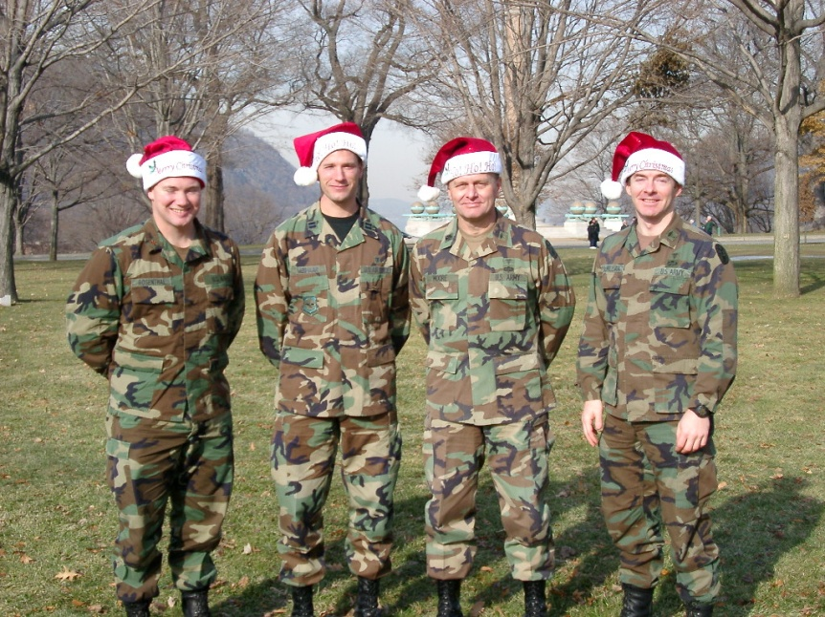
Class of 2003
Director: Joe Moore and then Paul Stoneman
Residents: Danny McMillan, Mark Weishaar, Mike Rosenthal
Curriculum, time, athletic training:
  First 18 month residency
  Baylor course curriculum followed
  Largely, a repeat of previous
  residency

Slide 39
Class of 2003
Director: Joe Moore and then Paul Stoneman
Residents: Danny McMillan, Mark Weishaar, Mike Rosenthal
Curriculum, time, athletic training:
  First 18 month residency
  Baylor course curriculum followed
  Largely, a repeat of previous
  residency
Notes:
Transition year – essentially, Paul was here for just the last few months of the residency. More tests, more research focus, etc.

Slide 40
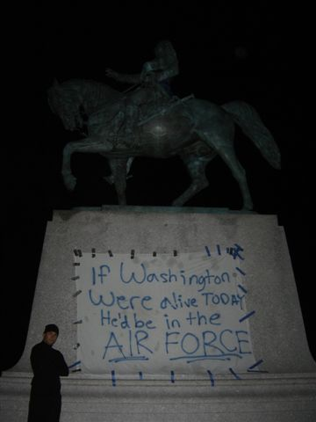
Notes:
Nice rivalry

Slide 41
West Point Post-Professional Sports Medicine-Physical Therapy Doctoral Residency: 2001-2011
Maj James Dauber
MAJ Mark Thelen
2007
CPT William Loro
LTC Paul Stoneman
Capt Michael Fink
MAJ Mike Johnson
2005
MAJ Page Karsteter
LCDR Shane Vath
Maj Mark Weishaar
LTC Danny McMillian
2003
LCDR Mike Rosenthal
COL Josef Moore
Lt Col Randy Green
LTC Richard Baxter
2001
LCDR Scott Jonson

Slide 42
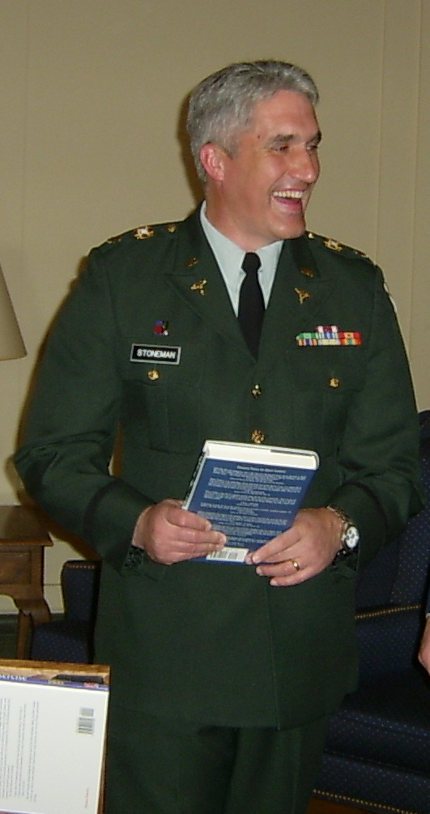
Paul Stoneman

Slide 43
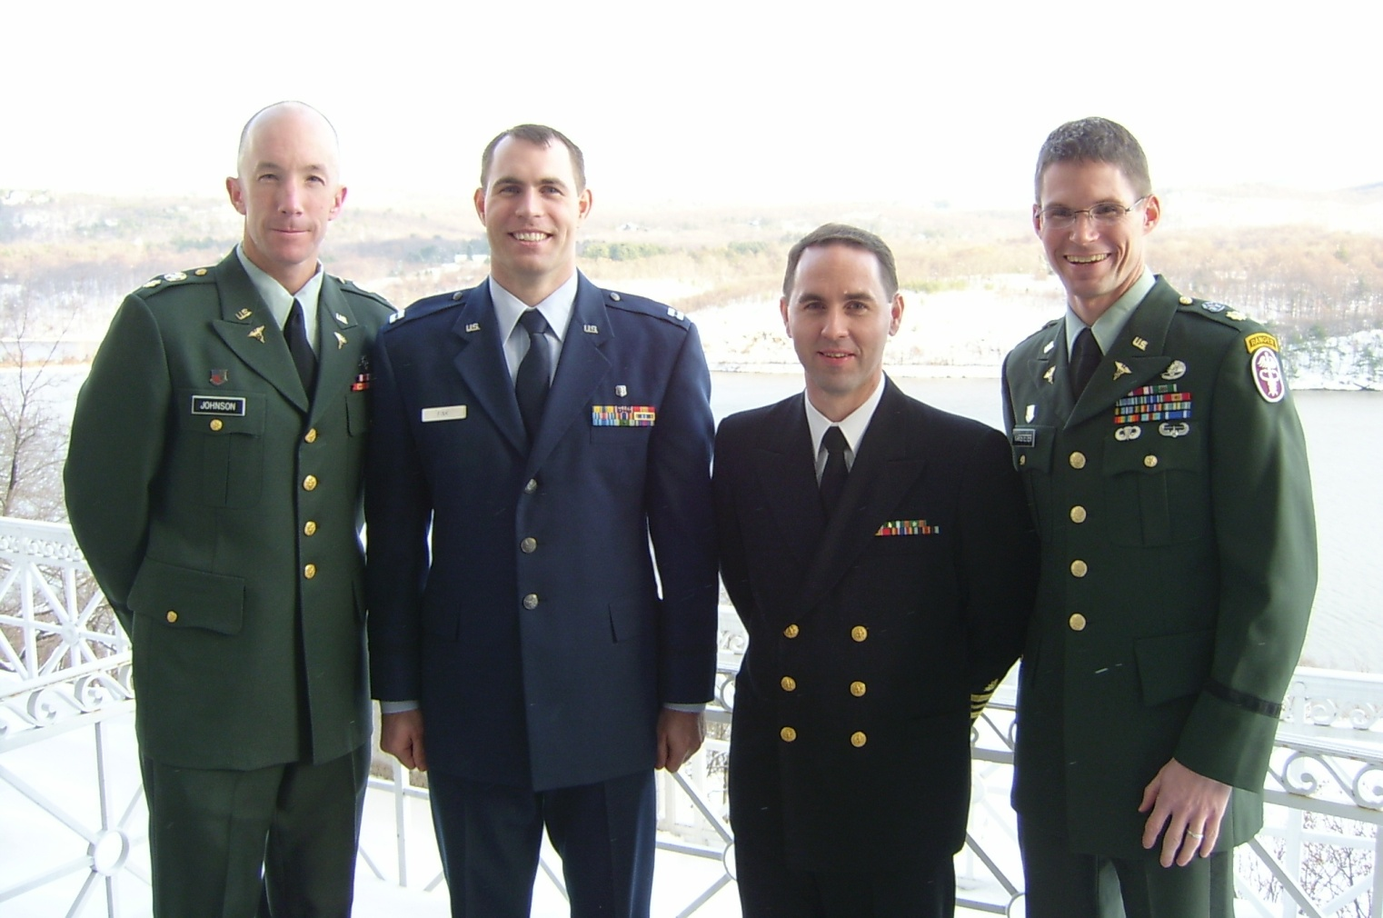
Class of 2005

Slide 44
Class of 2005
Director: Paul Stoneman
Residents: Michael Fink, Michael Johnson, Page Karsteter, Shane Vath
Curriculum, time, athletic training:
  Somewhat of a transition period – many challenges over the next 4 years
    Little program continuity existed: no former resident present
    Significant staffing problems: deployments without backfill, staff members in courses or with medical issues, very limited enlisted staff
    APTA revamped credentialed residency guidelines - no longer accepted the Baylor curriculum
    Switched to a new physical therapy clinic with a dedicated conference room and offices
Notes:
Paul also came from the school house so again brought a good amount of teaching experience with him.
Paul was left on an island in a sense to figure out things for himself – he had residency files and access to previous Directors, but without a former resident had to figure things out for himself in many instances.
His staffing was poor – he got pulled in many directions just trying to hold the clinics together.
The APTA increased requirements – The whole chaos from moving clinics occurred during this time as well.

Slide 45
Class of 2007
Director: Paul Stoneman
Residents: Bill Loro, James Dauber, Mark Thelen
Curriculum, time, athletic training:
  Due to the aforementioned challenges, many issues of the past slowed progress. The Director was pulled in so many directions that he couldn’t dedicate himself as much as he wanted to the residency.

Slide 46
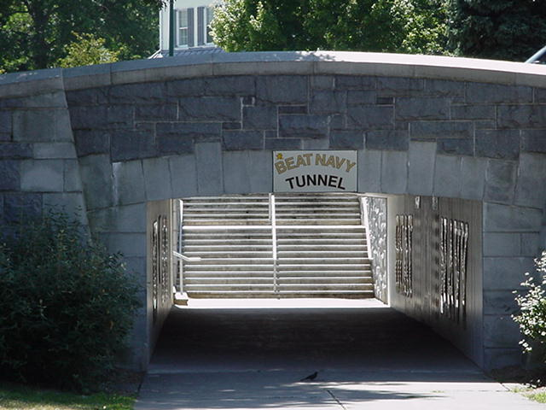

Slide 47
West Point Post-Professional Sports Medicine-Physical Therapy Doctoral Residency: 2001-2011
Maj Justin Theiss
CPT Scott Carow
2011
CPT(P) Angie Diebal
CPT Rich Westrick
CPT Joe Miller
LTC J. Parry Gerber
Capt Rick Clark
CPT Heath Todd
2009
MAJ Beth Mason
LCDR Brian Iveson
Maj James Dauber
MAJ Mark Thelen
2007
CPT William Loro
LTC Paul Stoneman
Capt Michael Fink
MAJ Mike Johnson
2005
MAJ Page Karsteter
LCDR Shane Vath
Maj Mark Weishaar
LTC Danny McMillian
2003
LCDR Mike Rosenthal
COL Josef Moore
Lt Col Randy Green
LTC Richard Baxter
2001
LCDR Scott Jonson

Slide 48
West Point Post-Professional Sports Medicine-Physical Therapy Doctoral Residency: 2013-
LTC Mike Johnson
MAJ Nate Shepard
MAJ Mike Garrison
CPT Scott Dembowski
2013

Slide 49
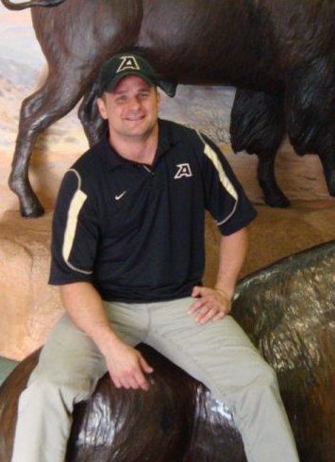
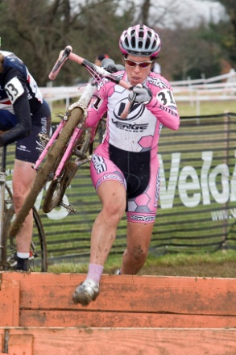
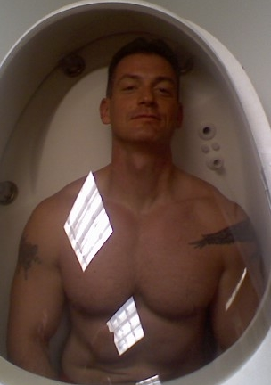
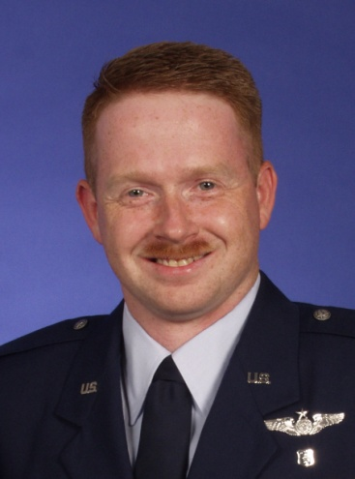
Class of 2009
Director: Parry Gerber
Residents: Heath Todd, Beth Mason, Brian Iveson, Richard Clark
Notes:
First former resident as a Director.

Slide 50
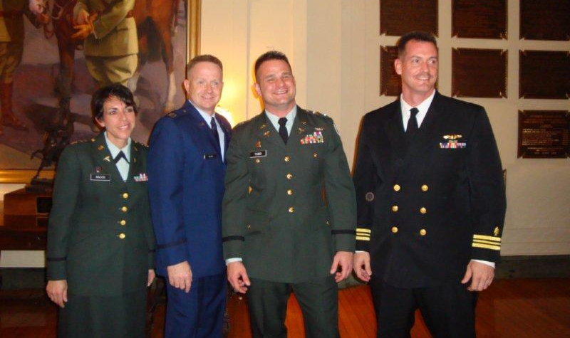
Class of 2009
Notes:
First former resident as a Director.

Slide 51
Class of 2009
Director: Parry Gerber
Residents: Heath Todd, Beth Mason, Brian Iveson, Richard Clark
Another transition time:
  Recredentialing the residency was not a trivial task. Many required items had to be added or modified to meet national APTA standards.
  There was concern from Baylor that consistency may be lacking between residencies and especially when there was a change in Directors.
  These 2 factors caused significant restructuring.
Notes:
First former resident as a Director.

Slide 52
Class of 2009
Director: Parry Gerber
Residents: Heath Todd, Beth Mason, Brian Iveson, Richard Clark
Curriculum, time, athletic training:
  The Director assigned a clinic chief at both the Keller and Cadet Clinic to handle all clinical matters to dedicate time more exclusively to the residency.
  Administrative details from the APTA and Baylor took significant time away from directly focusing on the residency
  Much more structured – school setting.
  Athletic training – the DPE staff developed a more standardized curriculum
Notes:
First former resident as a Director. Staffing was mostly stable during this time. Residents may have felt a little like guinea pigs at times – there were many instances we learned that some material should be required sooner, some tests may have been to complex, etc. – the result is a better program moving forward.

Slide 53
West Point Post-Professional Sports Medicine-Physical Therapy Doctoral Residency
REQUIRED: Complete and Submit Individual Research to Peer, Reviewed, Indexed Journal prior to graduation date!!
Example of research projects/publications from former graduates:
Side to Side Anthropometric Ultrasound Measurements of Lateral Abdominal Musculature; a Study of Competitive Collegiate Single Sided Rowers, Beth Mason
CPT Scott Carow
CPT(P) Angie Diebal
2011
Associations between three clinical assessment tools for postural stability, Rick Clark
CPT Rich Westrick
Interrater reliability of the Side-lying Thoraco-lumbar Rotation Measurement (STRM), Brian Iveson
LTC J. Parry Gerber
CPT Joe Miller
The Effects of Cryotherapy on Quadriceps Activity and Isometric Strength in Early Post-Operative Knee Surgery Patients, Loro W.
Capt Rick Clark
Foot Plantar Surface Pressure Patterns and Incidence of Lower Extremity Overuse Injuries in West Point New Cadets, Heath Todd
CPT Heath Todd
2009
MAJ Beth Mason
Use of a Modified Version of the Balance Error Scoring System (BESS) to Predict Ankle Sprains in a Military Population, Dauber J
LCDR Brian Iveson
The Swain Test for Medial Collateral Ligament Injuries of the Knee Karsteter PA, Stoneman PD, McCulloh I.
Maj James Dauber
The Clinical Efficacy of Kinesio Tape for Shoulder Pain: A Randomized, Double-Blinded, Clinical Trial, Thelen M
MAJ Mark Thelen
2007
Clinical Prediction Rules for Chronic Exertional Compartment Syndrome. Vath SA.
CPT William Loro
LTC Paul Stoneman
The Effects of an Acute Bout of Pre-Activity Static Stretching versus Ballistic Stretching on Hamstring Muscle Length and Horizontal Hopping Performance in Athletic Male Cadets with Hamstring Tightness Fink ML, Stoneman PD.
Capt Michael Fink
Comparison of Lateral Hop Versus a Forward Hop for Functional Evaluation of Lateral Ankle Sprains. Johnson M, Stoneman PD.
MAJ Mike Johnson
2005
MAJ Page Karsteter
The effect of functional training on chronic ankle instability. McMillian D, Moore JH, Stoneman PA
LCDR Shane Vath
Effect of prophylactic knee bracing on functional test performance in NCAA Div I football interior linemen. Rosenthal MD, Moore JH,
Supervised Clinic-based Physical Therapy versus Home Exercise in the Treatment of Acute Lateral Ankle Sprains. Weishaar MD, Green RA, Moore JH, Pendergrass TLSilvka E, Goss DL, Stoneman P 2004 Sports Physical Therapy Section Excellence in Research Award
Maj Mark Weishaar
LTC Danny McMillian
2003
Sit-up performance associated with two different training regimens. Baxter RE, Moore JH, Pendergrass TL, Crowder TA, Lynch S.
LCDR Mike Rosenthal
Prospective double blinded comparison of supervised exercise with and without manual therapy for patients with acute lateral ankle sprains. Green RA, Moore JH, Pendergrass TL, Lynch SM, Vought RM. Louise House Award for best poster at SOMOS.
COL Josef Moore
Lt Col Randy Green
LTC Richard Baxter
2001
Training and lower extremity biomechanical risk factors associated with metatarsal stress fractures in army cadets at the united states military academy. Jonson SR, Moore JH, Pendergrass TL, Taylor DC, Cameron KL, Fellows DW.
LCDR Scott Jonson
Notes:
Projects and publications

Slide 54
Recipient of the 2003 Sports Physical Therapy Section Excellence in Research Award: Clinical Diagnostic Accuracy and Magnetic Resonance Imaging of Patients Referred by Physical Therapists, Orthopaedic Surgeons, and Nonorthopaedic Providers Josef H. Moore, Donald Lee Goss, Richard E. Baxter, Thomas M. DeBerardino, Liem T. FEBRUARY 2005 Volume 35, No. 2
Risk Determination for Patients With Direct Access to Physical Therapy in Military Health Care Facilities
Josef H. Moore, Danny J. McMillian, Marc D. Weishaar, Michael D. Rosenthal OCTOBER 2005 Volume 35, No. 10
Deep Vein Thrombosis in an Athletic Military Cadet. J Orthop Sports Phys Ther. 2006;36(9):686-697. doi:10.2519/jospt.2006.2251 Fink ML, Stoneman PD.
Bilateral Distal Fibular Stress Fractures in a Young Military Cadet. Fink ML.
Identification and Management of 2 Femoral Shaft Stress Injuries Marc D. Weishaar, Danny J. McMillian, Josef H. Moore JOSPT OCTOBER 2005 Volume 35, No. 10
Karsteter PA, Yunker C. Recognition and Management of an Orbital Blowout Fracture in in Amateur Boxer. J Orthop Sports Phys Ther. 2006;36(8):611-618. doi:10.2519/jospt.2006.2207
Clonus in a Rugby Player and Return to Sports after Transient Neurological Injury. Karsteter PA, Stoneman PD.
Evaluation of a Subscapularis tear in a Female Athlete with Shoulder Instability. Johnson M.
Diagnosis and Treatment of Acute Exertional Rhabdomyolysis Richard E. Baxter, Josef H. Moore JOSPT MARCH 2003 Volume 33, No. 3
Resident's Case Problem: Identification of a Fibular Fracture in an Intercollegiate Football Player in a Physical Therapy Setting Donald Lee Goss, Josef H. Moore, Darryl B. Thomas, Thomas M. DeBerardino JOSPT APRIL 2004 Volume 34, No. 4
Unilateral hypoglossal nerve injury in a college wrestler: A case report. Loro WA, Owens BD. (in publication with J Athl Trng)
Diagnosis of Medial Knee Pain: Atypical Stress Fracture About the Knee Joint Josef H. Moore, Thomas M. DeBerardino, Michael D. Rosenthal JULY 2006 Volume 36, No. 7
Dynamic vs. static-stretching warm up: the effect on power and agility performance. McMillian DJ, Moore JH, Hatler BS, Taylor DC. J Strength Cond Res. 2006 Aug;20(3):492-9.
Differential diagnosis of shoulder pain followed by progressive weakness. A case report. Rosenthal M. Journal of Special Operations Medicine. Accepted for publication
Neuromuscular excitability changes in the vastus medialis following anterior cruciate ligament reconstruction. Rosenthal M. Electromyography and Clinical Neurophysiology. 49(1):43-51, 2009.
Acute painless shoulder weakness during high-intensity athletic training. Rosenthal M. American Journal of Sports Medicine. 37(1):175-180, 2009.

Slide 55
Hypothenar Hammer Syndrome: case report with clinical and infrared thermographic correlations. Molloy JM, Pascoe DD, Smith JW, Purohit RC, Herrick RT. Thermology International. 2005; 15 (2).
Effects of early progressive eccentric exercise on muscle structure after anterior cruciate ligament reconstruction. Gerber JP, Marcus RL, Dibble LE, Greis PE, Burks RT, LaStayo PC J Bone Joint Surg Am. 2007 Mar;89(3):559-70.
Safety, feasibility, and efficacy of negative work exercise via eccentric muscle activity following anterior cruciate ligament reconstruction. Gerber JP, Marcus RL, Dibble LE, Greis PE, Burks RT, LaStayo PC. J Orthop Sports Phys Ther. 2007 Jan;37(1):10-8.
COL Josef Moore
Postural control after a 2-mile run. Pendergrass TL, Moore JH, Gerber JP: Mil Med. 2003 Nov; 168(11):896-903.
LTC Tim Pendergrass
Early Application of Negative Work via Eccentric Ergometry Following Anterior Cruciate Ligament Reconstruction: A Case Report. Gerber JP, Marcus RL , Dibble LE, Greis P, LaStayo PC. J Orthop Sports Phys Ther. 2006 May;36(5):298-307.
LTC Allyson Pritchard
1999
Lt Col Steve Steocker
High-intensity resistance training amplifies muscle hypertrophy and functional gains in persons with Parkinson’s disease. Dibble LE, Hale TF, Marcus RL, Droge J, Gerber JP, LaStayo PC. Mov Disord. 2006 Sep:21(9):1444-52.
LTC Barb Springer
LCDR Rod Clayton
1997
LTC Greg Weaver
Comparison of the Single Assessment Numeric Evaluation method and two shoulder rating scales. Outcomes measures after shoulder surgery. Williams GN, Gangel TJ, Arciero RA, Uhorchak JM, Taylor DC. Am J Sports Med. 1999 Mar-Apr;27(2):214-21.
LTC Timothy Gangel
1996
Evaluation of the sports ankle rating system in young, athletic individuals with acute lateral ankle sprains. Williams GN, Molloy JM, DeBerardino TM, Arciero RA, and Taylor DC: Foot & Ankle International, 2003; 24(3).
COL Joseph Molloy
Comparison of the single assessment numeric evaluation method and the Lysholm score. Williams GN, Taylor DC, Gangel TJ, Uhorchak JM, Arciero RA. Clin Orthop Relat Res. 2000 Apr;(373):184-92.
Persistent Disability Associated with Ankle Sprains: A Prospective Examination of an Athletic Population. Gerber JP, Williams GN, Scoville CR, Arciero RA, Taylor DC. Foot & Ankle International, 1998 Oct;19(10):653-660.
LTC Chuck Scoville
LTC J. Parry Gerber
1995
LTC Steve Bullock
Influence of Running Shoe Type on Distribution and Magnitude of Plantar Pressures among Those with Pes Planus or Pes Cavus Feet. Molloy JM, Yeykal NS, Tragord BS, Neal MS, Nelson ES, Christie DS, Teyhen DS, McPoil TM Clin Biomech 2008; 23(5): 708-709.
Notes:
Green – projects at west point that were published –
Yellow – projects from residents after they left West Point

Slide 56
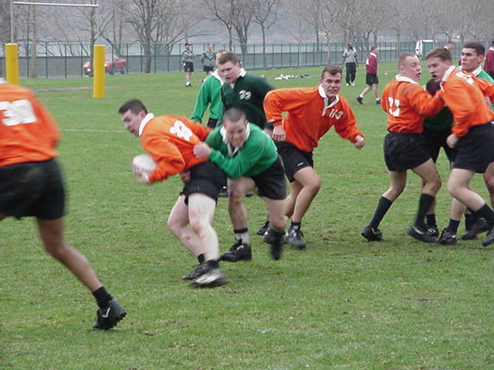
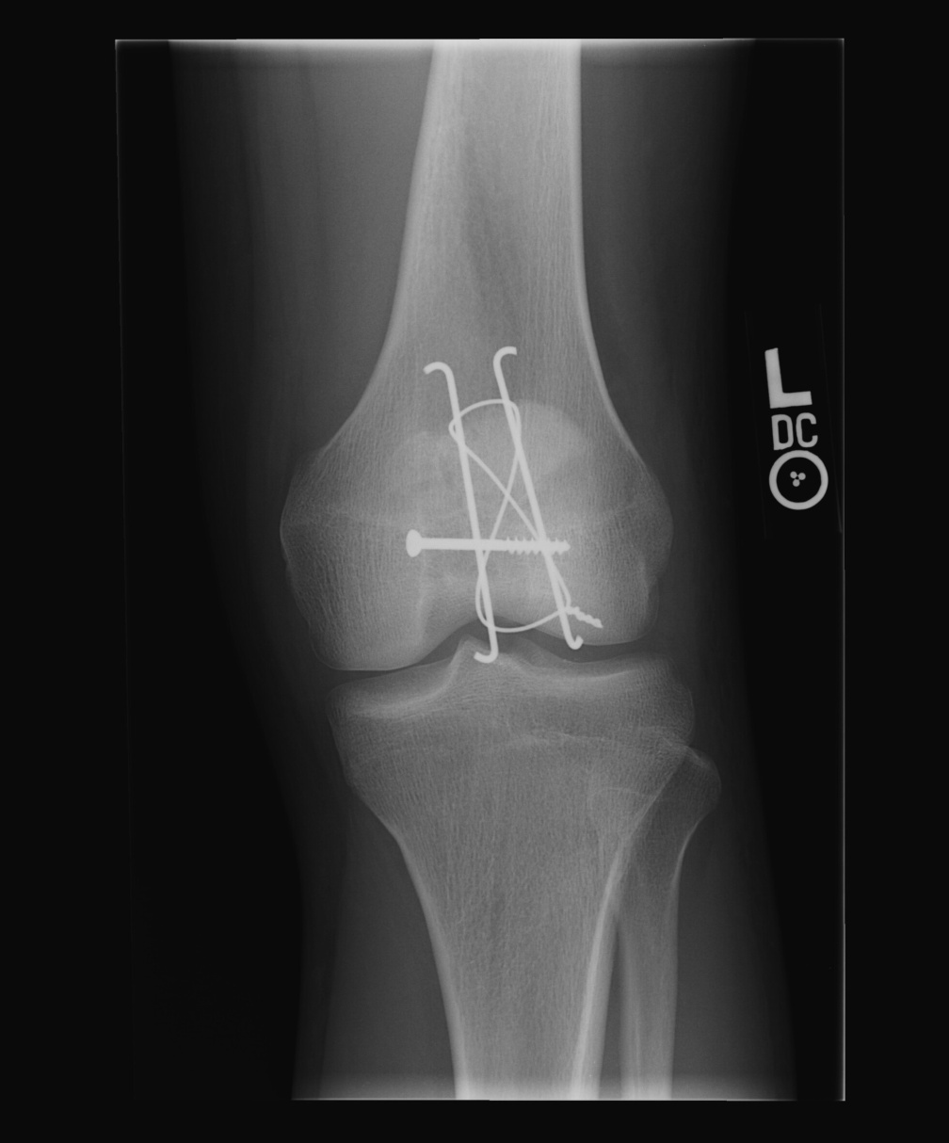
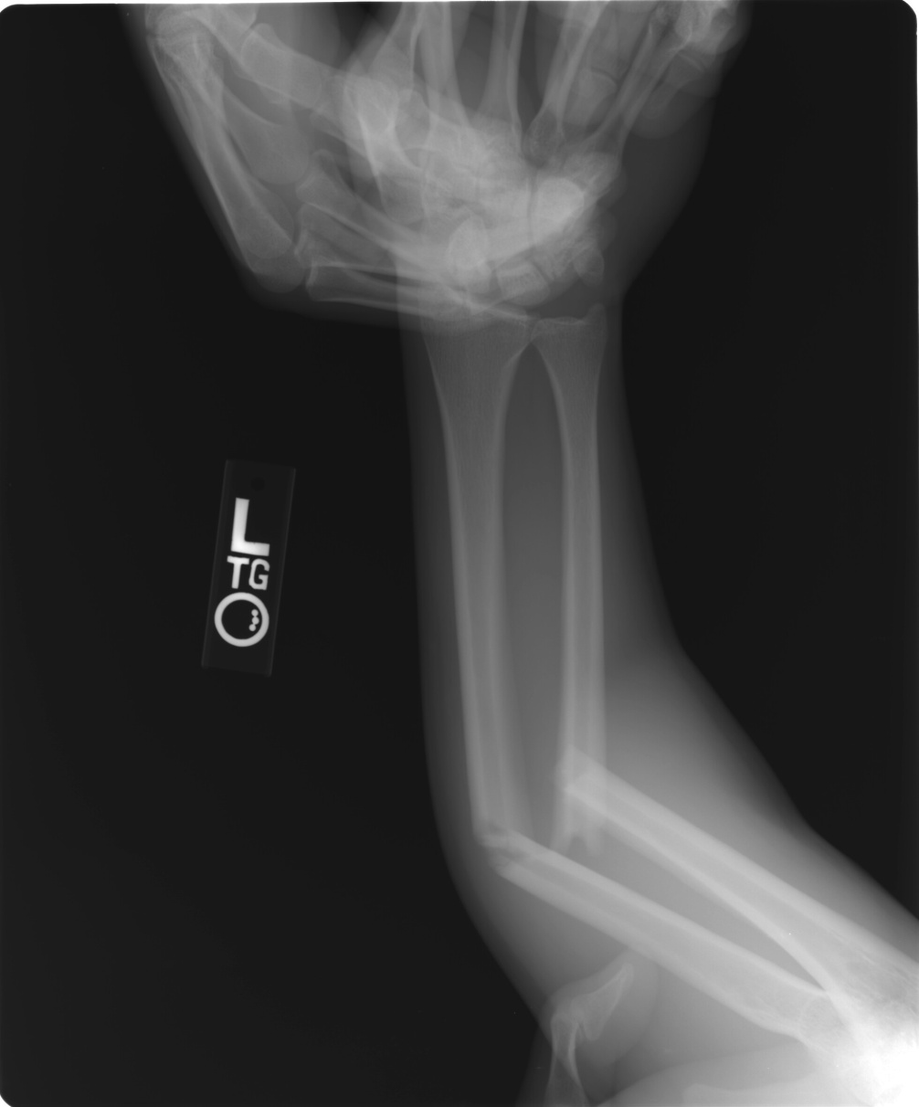
Relative Risk of Injury Associated with Participation in Intramural Rugby at the United States Military Academy. Cameron KL, Yunker CA, Koesterer AC. Journal of Athletic Training, Vol. 36(S), May 2001.
Incidence of injury: 22.31 injuries per 100 players or 15.86 injuries per 1000 exposures to injury. Overall 605 injuries by athletes exposed to injury 38,151 times
Cadet stuck arm into scrum on his first day of practice.
(L) Radial-Ulnar fracture (Both Bones Fracture)
Neuro-Vascular status: intact
Obvious deformity of (L) forearm
DOS: 12 Apr 01
Cadet had Knee-to-knee impact -- Limped off field with assistance. Weight-bearing but with pain --kneecap looks different -- Visible and Palpable patellar defect.
Dx: Tripod patellar fracture.
Surgery: ORIF of comminuted intra-articular fx of patella – 8mm separation of fragments
Notes:
Some of the things you may see.

Slide 57
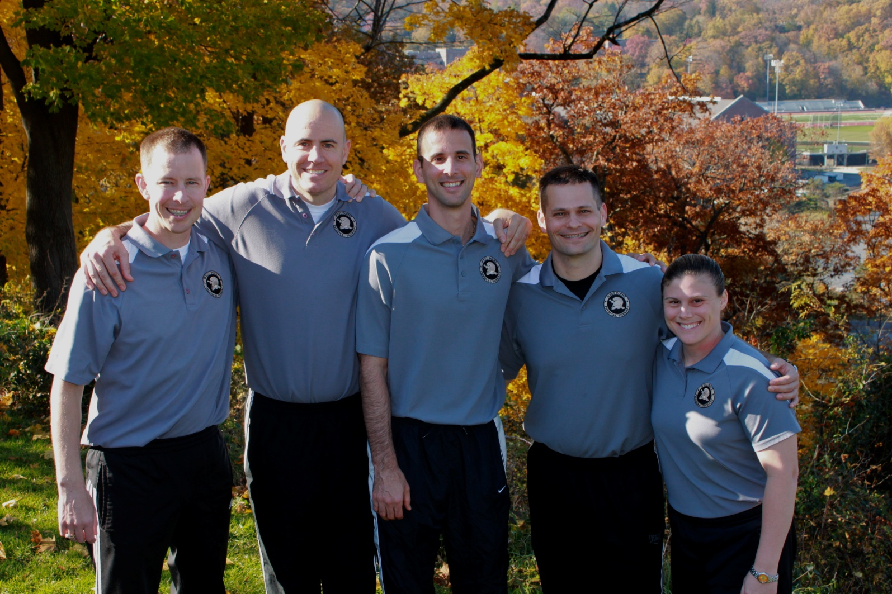
Class of 2011
Notes:
First with 5 residents.
Fellowship plus residency. May become directors or staff for future residencies.

Slide 58
Class of 2011
Director: Parry Gerber
Residents: Scott Carow, Angie Diebal, Rich Westrick, Joe Miller, Justin Theiss
Quite possibly the most productive of any previous group
  > 10 journal articles/chapters published
  Many notable athletic training venue coverages – warrior games, World Games in Brazil, Army 10-miler, All-Army Basketball, etc.
Notes:
First former resident as a Director.

Slide 59
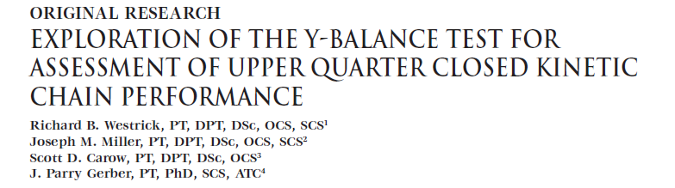
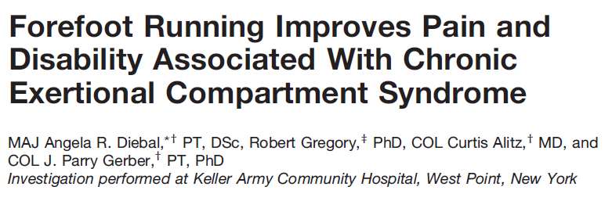
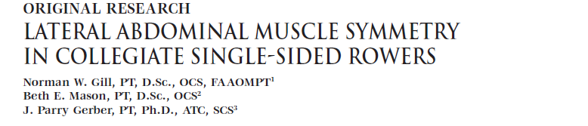
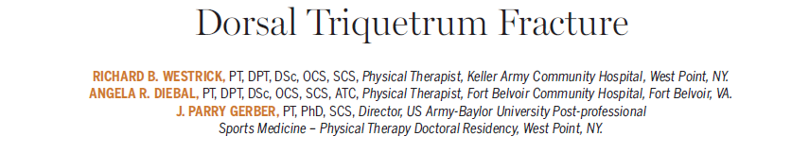
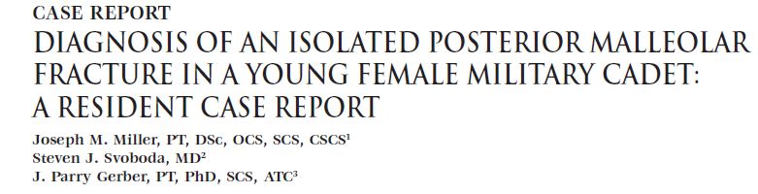
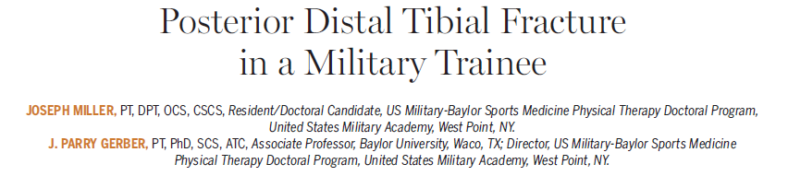
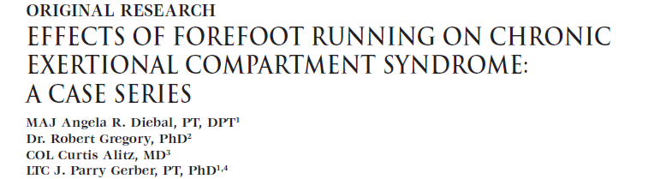
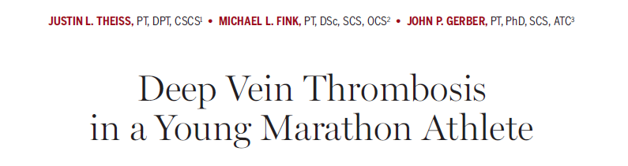
West Point
US Military-Baylor Sports-Medicine Residency and Doctoral Program
Publications: May 2011-May 2012
U.S. Military- Baylor University
Post-professional Sports Medicine- PT Doctoral Program
West Point, New York
Notes:
Note – 3rd semester course – but you can have the imaging case completed as soon as you find an interesting case. If another comes available we will still want to write it up.

Slide 60
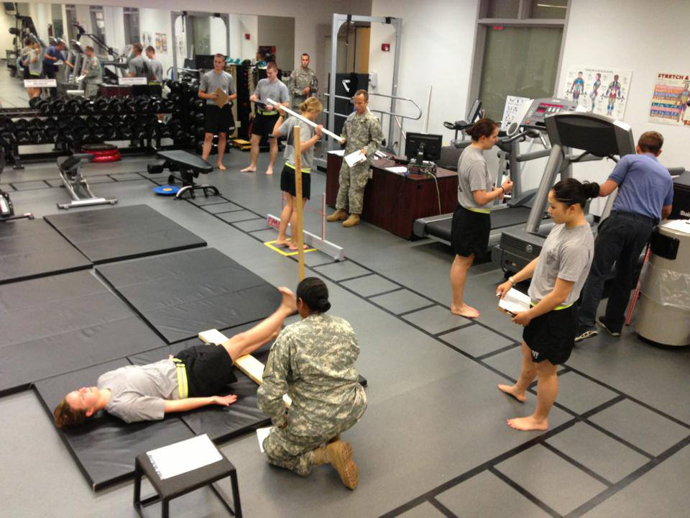
Class of 2013
Director: Mike Johnson
Residents: Scott Dembowski, Nate Shepard, Mike Garrison
Notes:
First with 5 residents.
Fellowship plus residency. May become directors or staff for future residencies.

Slide 61
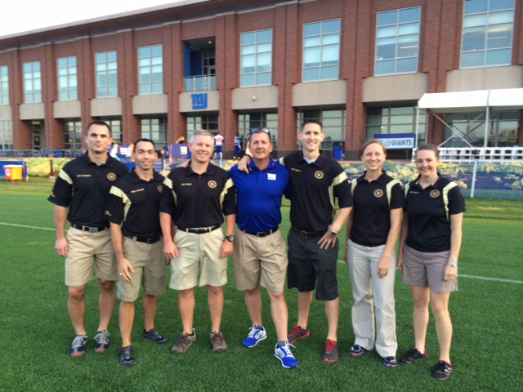
Class of 2015
Director: Don Goss
Residents: Jeff Dolbeer, Jamie Morris, John Mason, Aspen Heger

